Slide 1


Determining Mediterranean Restaurant Location
Luka Marunic

Slide 2


Using Data For Location Searching
Data can provide insights that Human intuition can not
Opening a restaurant is costly, need to get it right
Quicker process than using surveys alone

Slide 3

Problem
Toronto is a diverse city and has a large Mediterranean population, where is the best spot to open a restaurant
The Mediterranean population in Toronto is spread out which neighbourhoods would be most receptive to a new Mediterranean restaurant

Slide 4
Data Acquisition & Cleaning
Demographic data from (https://en.wikipedia.org/wiki/Demographics_of_Toronto)
Geographical data from(https://cocl.us/Geospatial_data)
Restaurant data from(https://foursquare.com/)
Remove any entry where there were more than two values missing
Merge the demographic and geographic data frames

Slide 5
Clustering
The best way to find a suitable neighbourhood is group together by characteristics such as:
Average family income
Number of Mediterranean's in the neighbourhood
Number of Mediterranean restaurants in the neighbourhood

Slide 6
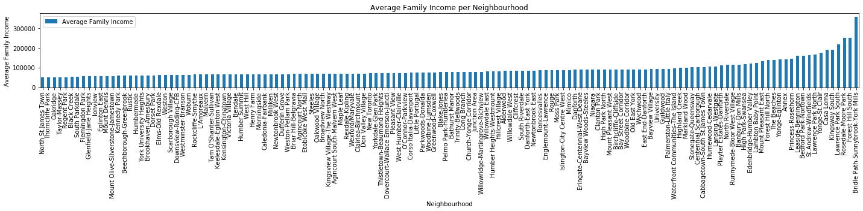
Average Household Income

Slide 7
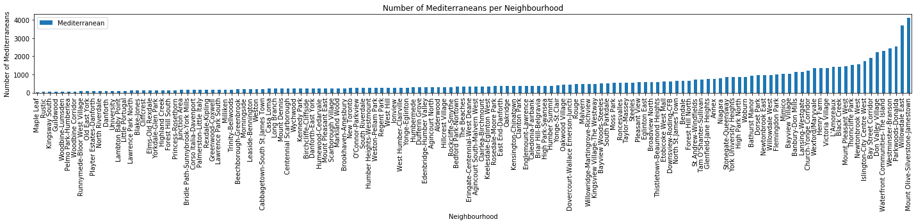
Mediterranean's per Neighbourhood

Slide 8
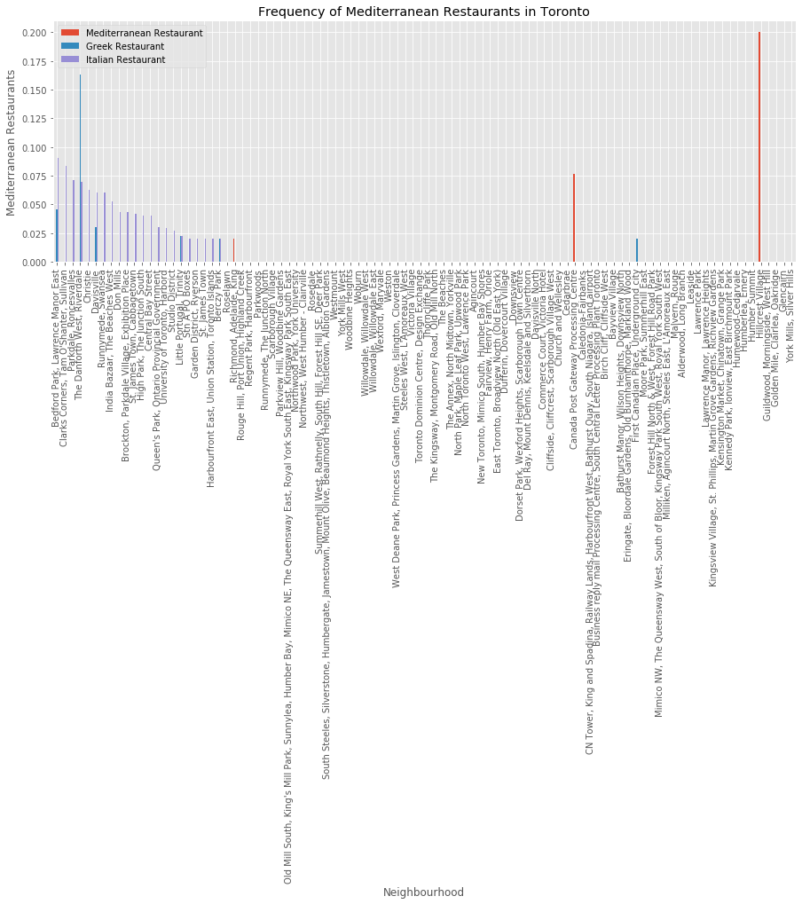
Mediterranean Restaurants

Slide 9
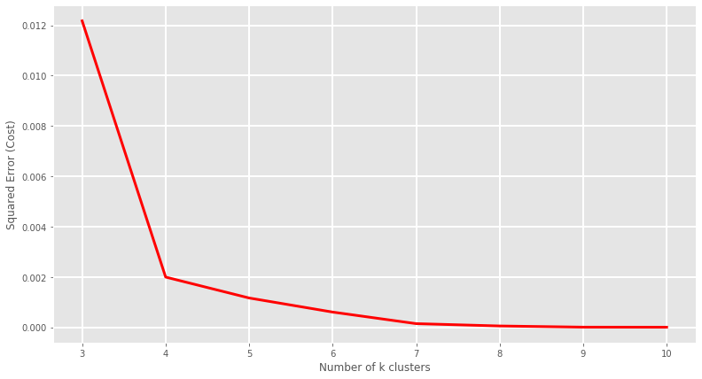
Number of Clusters
Using the previous factors looking at squared error on the y axis provides us with the ideal number of clusters being 4

Slide 10
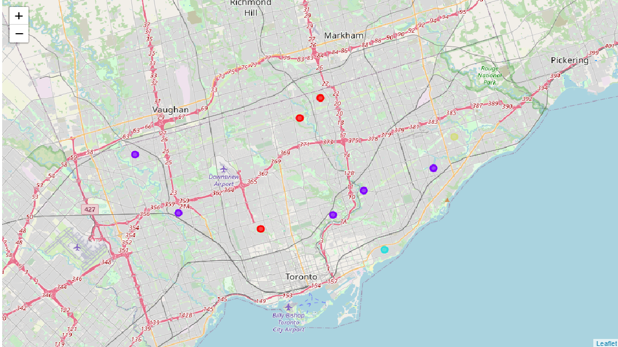
Location of Clusters

Slide 11
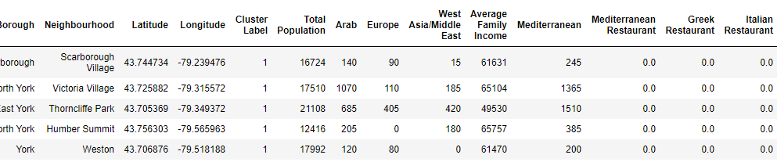
Best Cluster for Mediterranean Restaurant
Cluster contains largest Mediterranean population
Little to no competition from similar restaurants
Mid tier household income

Slide 12
Best Neighbourhoods
Victoria Village
Thorncliffe Park

Slide 13
Conclusion & Next steps
Many different factors in deciding where to place a restaurant
Key factors include: Average Household income, Other similar restaurants and Mediterranean population
Two best neighbourhoods are Victoria Village and Thorncliffe Park
Next steps to survey the population in these neighbourhoods to get more in depth look at viability of a new restaurant

